Slide 1

Applied Physics For Engineers (PHY-121)
CIIT, Attock
Lecture 03

Slide 2
Electric Charge and Coulomb’s Law

Slide 3
Fundamental Charge: The charge on one electron.
e = 1.6 x 10 ⁻¹⁹ C
Unit of charge is a Coulomb (C)

Slide 4
Two types of charge:
Positive Charge: A shortage of electrons.
Negative Charge: An excess of electrons.
Conservation of charge – The net charge of a closed system remains constant.

Slide 5
-
Nucleus
-
-
n
+
n
-
+
+
n
n
n
+
-
+
n
+
-
-
-

Slide 6
Negative Atom
Number of electrons > Number of protons
Positive Atom
Number of electrons < Number of protons
Neutral Atom
Number of electrons = Number of protons

Slide 7
Electric Forces
Like Charges - Repel
F
+
+
F
Unlike Charges - Attract
-
F
F
+

Slide 8
Coulomb’s Law – Gives the electric force between two point charges.
Inverse Square
Law
k = Coulomb’s Constant = 9.0x10⁹ Nm²/C²
q₁ = charge on mass 1
q₂ = charge on mass 2
r = the distance between the two charges

Slide 9
Example 1
Two charges are separated by a distance r and have a force F on each other.
F
q₁
q₂
F
r
If r is doubled then F is :
¼ of F
If q₁ is doubled then F is :
2F
If q₁ and q₂ are doubled and r is halved then F is :
16F

Slide 10
Example 2
Two 40 gram masses each with a charge of 3μC are placed 50cm apart. Compare the gravitational force between the two masses to the electric force between the two masses. (Ignore the force of the earth on the two masses)
3μC
40g
3μC
40g
50cm

Slide 11
The electric force is much greater than the gravitational force

Slide 12
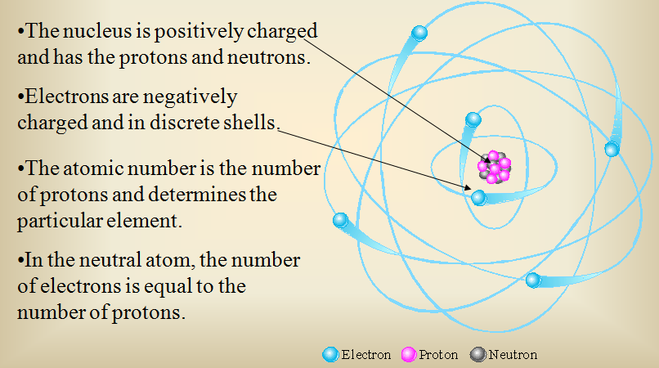
CIIT, Attock
Structure of Matter

Slide 13
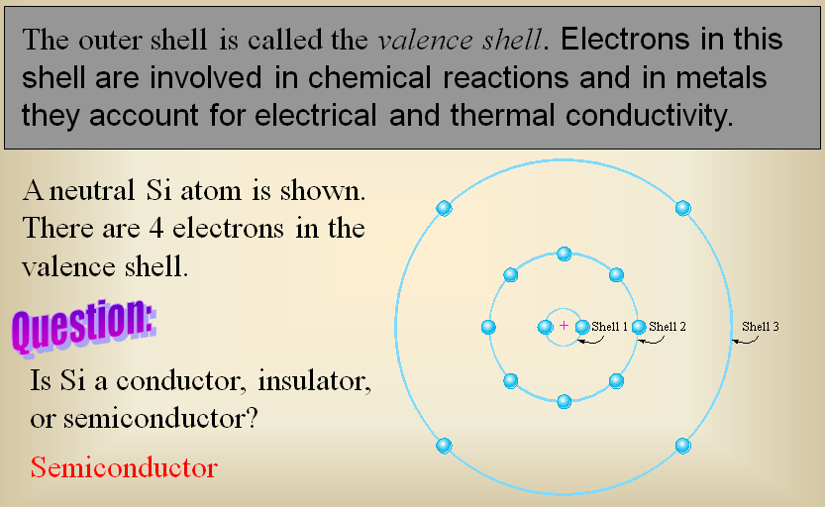
CIIT, Attock
Structure of Matter

Slide 14
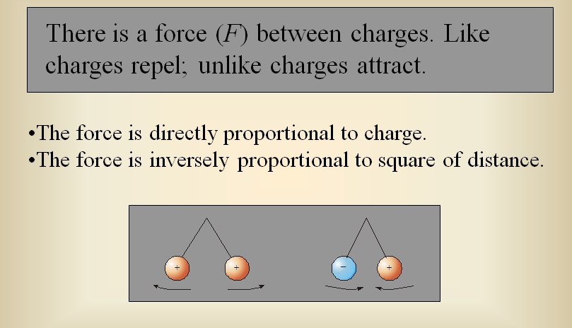
CIIT, Attock
Structure of Matter

Slide 15
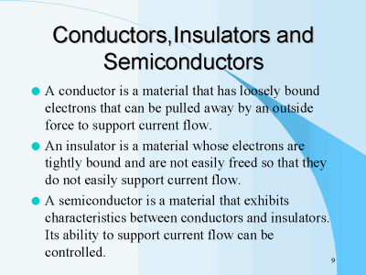
CIIT, Attock

Slide 16
Electromotive Force (Voltage)

Slide 17
Potential difference is the difference between two terminals.
Emf formula E = W / Q
Emf is denoted by
The unit for electromotive force is Volt.
PUMPING CHARGES:
It is used for steady flow of charges through the resistor.

Slide 18
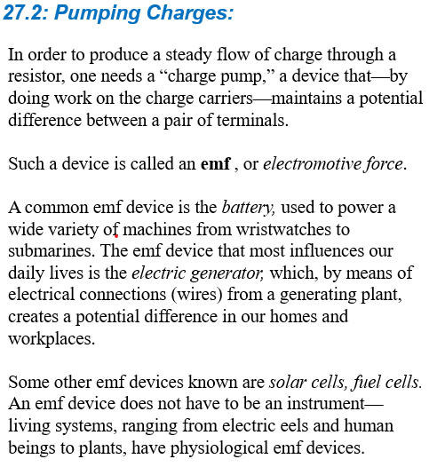




























.

Slide 19
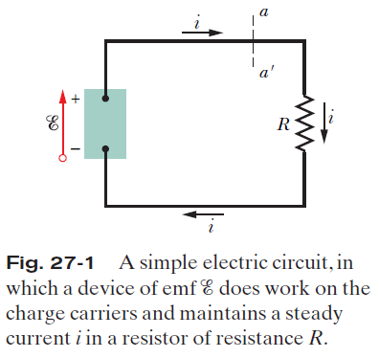
Pumping Charges:
In order to produce a steady flow of charge through a resistor, one needs a “charge pump,” a device that—by doing work on the charge carriers—maintains a potential difference between a pair of terminals.
Such a device is called an emf device, which is said to provide an emf.
(emf stands for electromotive force)

Slide 20
Pumping Charges:
A common emf device is the battery. The emf device that most influences our daily lives is the electric generator, which, by means of electrical connections (wires) from a generating plant, creates a potential difference in our homes and workplaces.
Some other emf devices known are solar cells, etc

Slide 21
An ideal emf device is one that has no internal resistance to the internal movement of charge from terminal to terminal. The potential difference between the terminals of an ideal emf device is exactly equal to the emf of the device.
A real emf device, such as any real battery, has internal resistance to the internal movement of charge. When a real emf device is not connected to a circuit, and thus does not have current through it, the potential difference between its terminals is equal to its emf. However, when that device has current through it, the potential difference between its terminals differs from its emf.

Slide 22
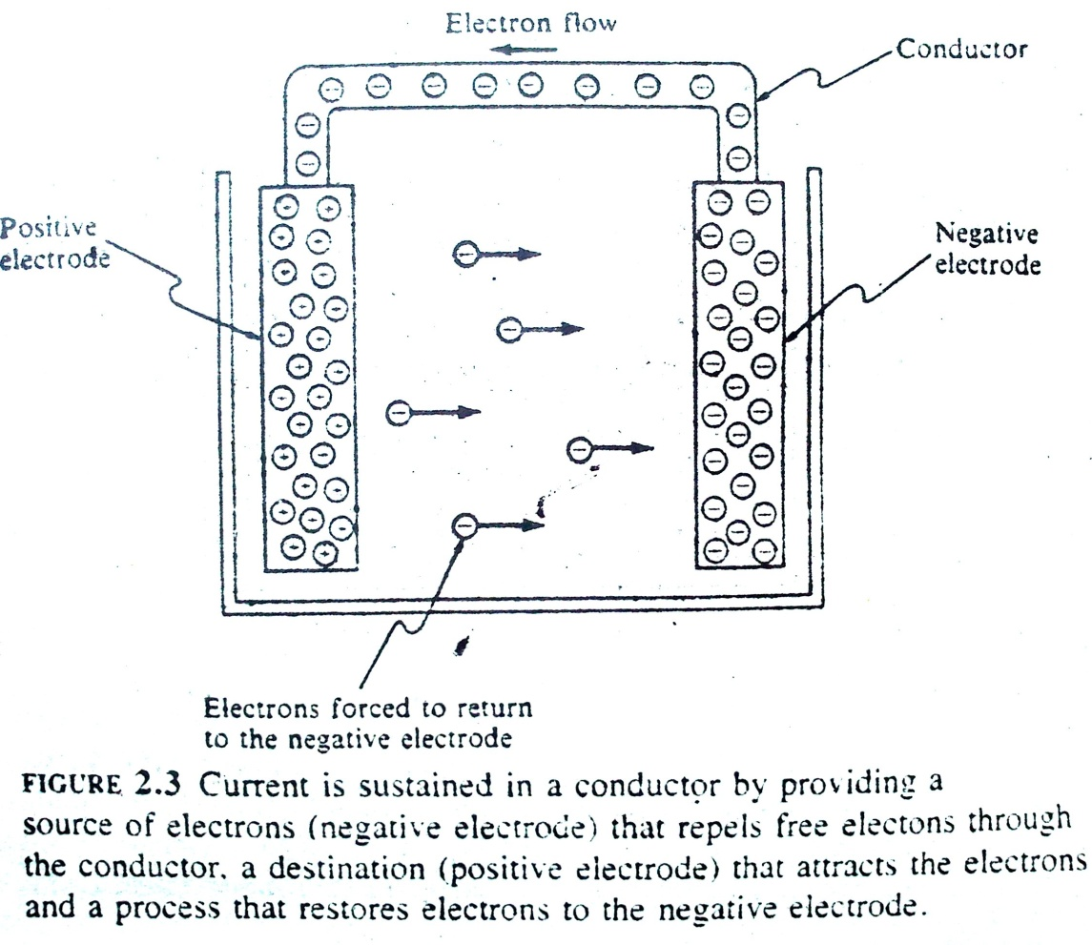
CIIT, Attock
Electromotive Force (Voltage)
The force required to establish flow of charge through conductor (OR force to move electrons that carry the charge).
The source of EMF is called voltage source.

Slide 23
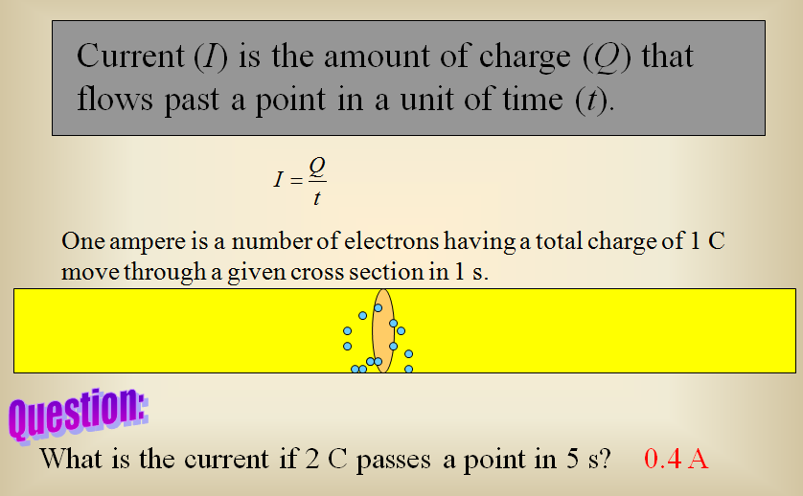
CIIT, Attock
Current

Slide 24
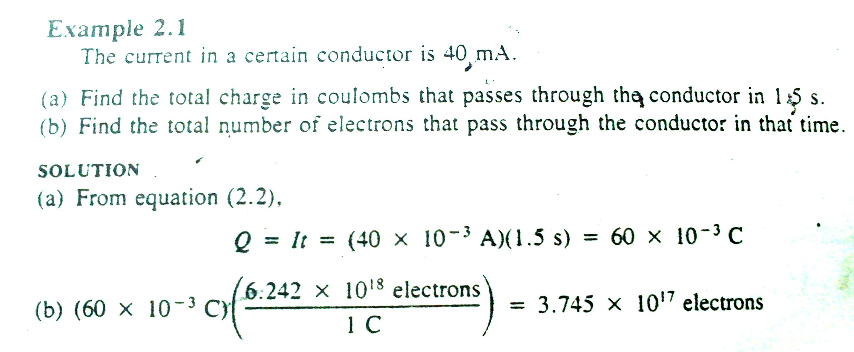
CIIT, Attock
6.242x10^18 electrons can carry 1C charge.

Slide 25
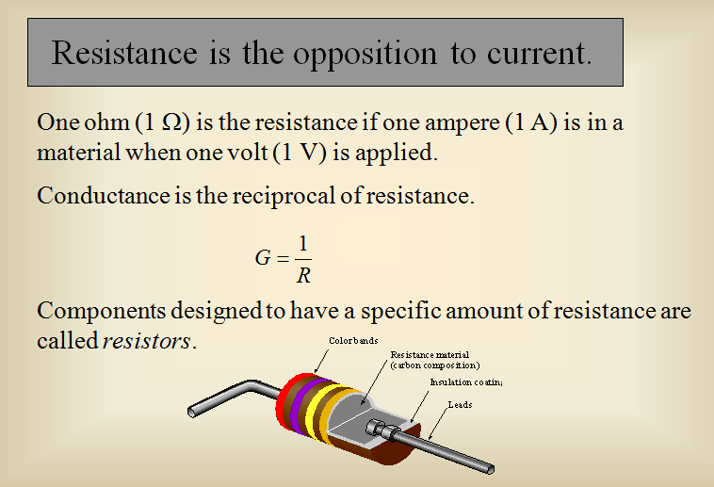
CIIT, Attock

Slide 26
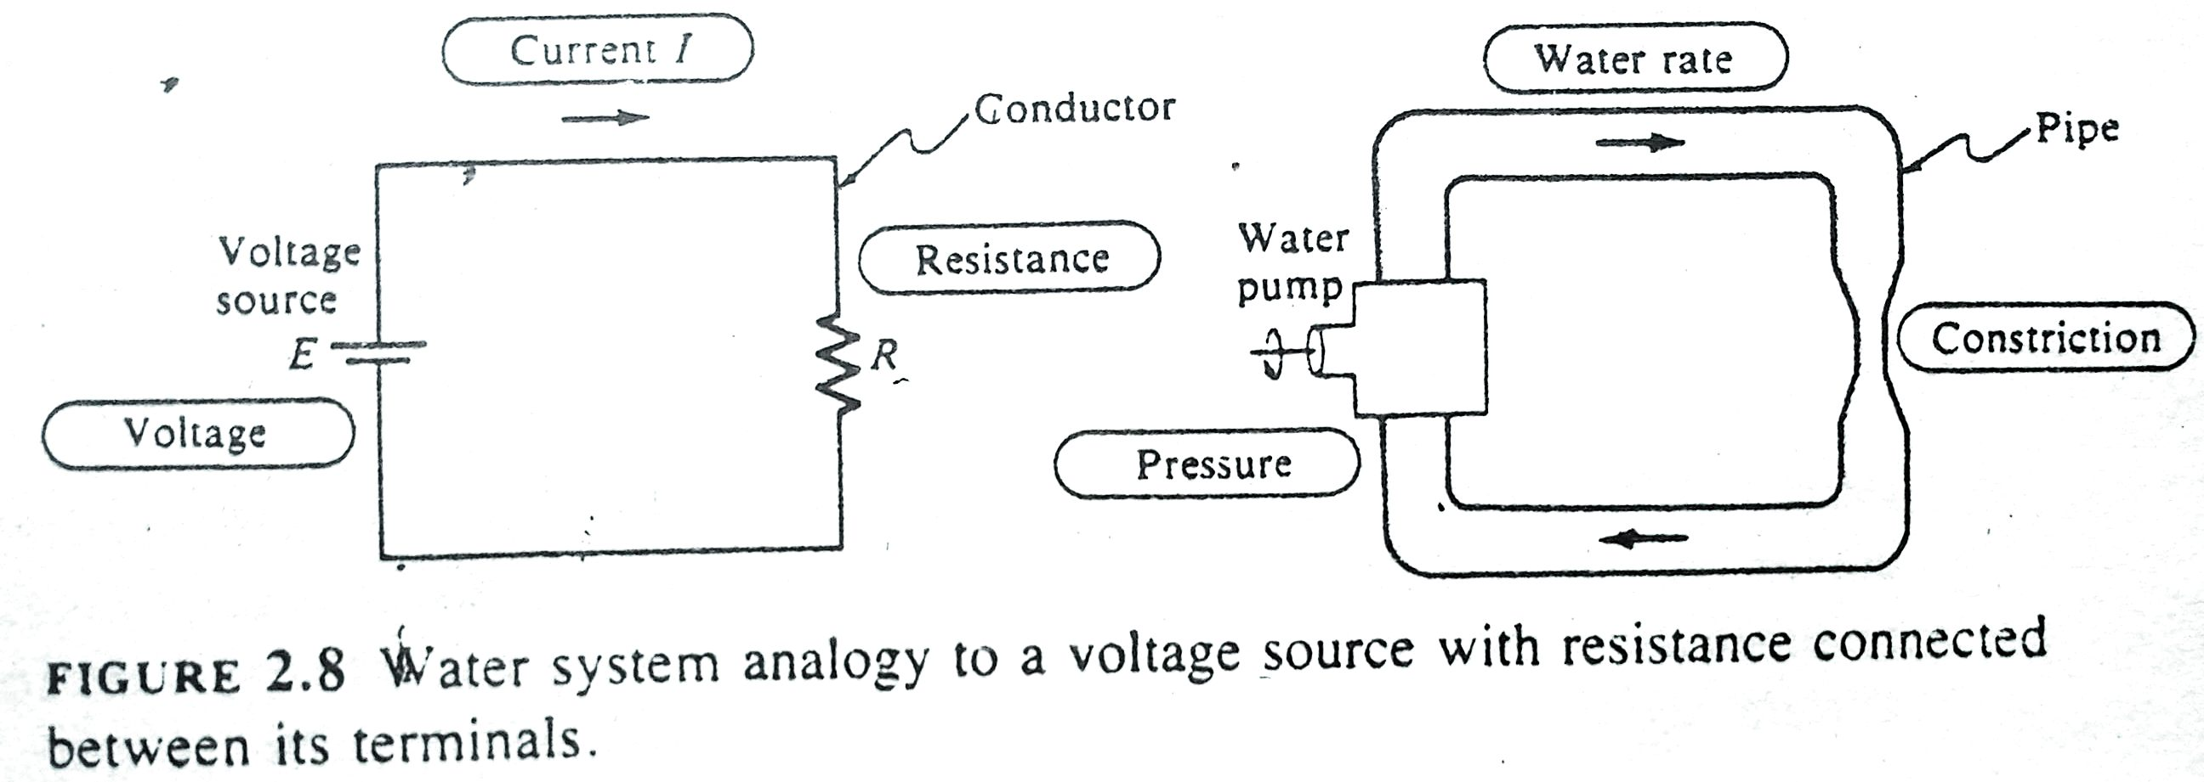
CIIT, Attock
Electric Circuit vs Water system

Slide 27
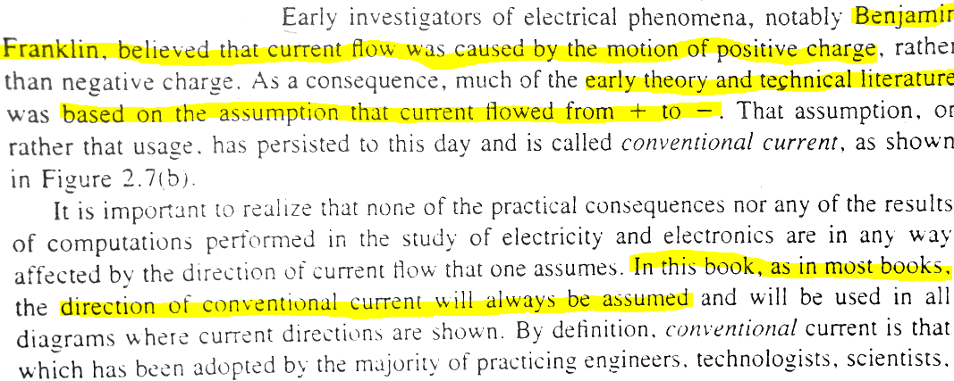
CIIT, Attock
Electron current Vs Conventional Current
Eletric current flow from –ve to +ve and convetional current flow from +ve to –ve.

Slide 28
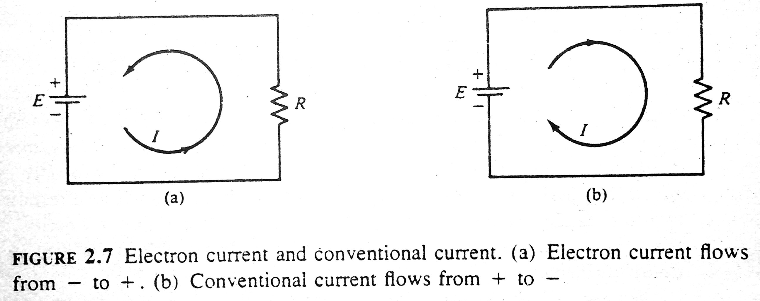
CIIT, Attock
Electron current Vs Conventional Current

Slide 29
CIIT, Attock
Electron current Vs Conventional Current

